Slide 1

Jazz
My favourite type of music
M VOMVAS
ST 1
Apostollos Varnava School

Slide 2
Definition of Jazz
Jazz music is a broad style of music characterized by complex harmony, syncopated rhythms, and a heavy emphasis on improvisation
Jazz is a music category that originated in the African-American communities of New Orleans, Louisiana, United States, in the late 19th and early 20th centuries, with its roots in blues and ragtime
Since the 1920s Jazz Age, it has been recognized as a major form of musical expression in traditional and popular music
1. jazz | Definition, History, Musicians, & Facts | Britannica
2. Jazz - Wikipedia

Slide 3
Why I love jazz music
Listening to the smooth sounds of jazz relieves tension and stress
Jazz stimulates the mind and improves focus
The more you listen to jazz, the more creative you will be. Jazz is far from boring music

Slide 4
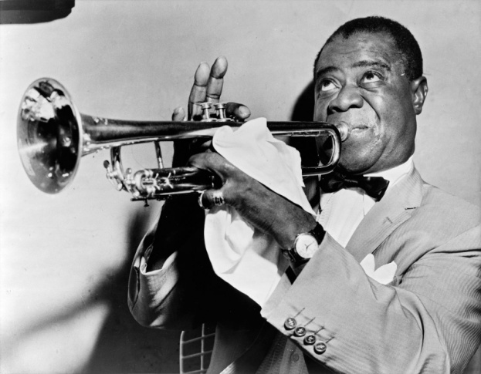
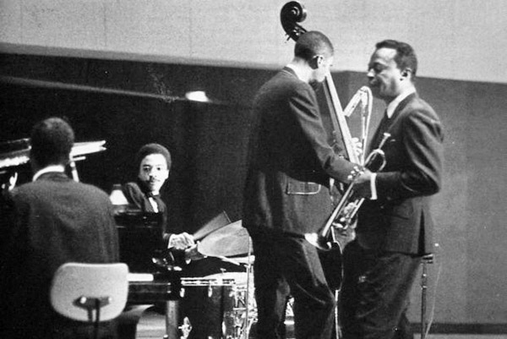

Jazz music popular bands
Louis Armstrong
Miles Davis Quintet
Charlie Parker
Duke Ellington
www.birminghamtimes.com

Slide 5
Best jazz songs
Louis Armstrong – ‘What A Wonderful World’
Miles Davis – ‘So What’
Duke Ellington & His Famous Orchestra – ‘Mood Indigo’
Ella Fitzgerald & Louis Armstrong – ‘Summertime’
Top 10 Most Famous Jazz Songs of All Time - Jazzfuel

