Slide 1

My favourite music
MARTHA IOANNOU
Στ 1

Slide 2


What kind of music is it?
Rock is a kind of music that is characterized by a strong beat and the presence of rock instruments, like the electric guitar, electric bass, electric organ and electric piano.

Slide 3

When did this music begin?
Rock music started as ‘rock and roll’ music in the United States of America before about 70 years.

Slide 4

Why do you like this kind of music?
I like this music because I enjoy the rhythm and the sounds of the electric instruments.

Slide 5
Popular rock bands
Beatles
Rolling Stones
Queen
AC/DC
Pink Floyd

Slide 6
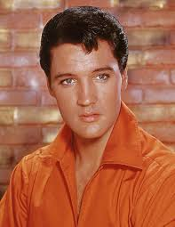
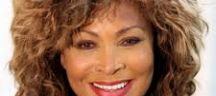
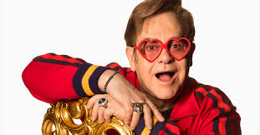
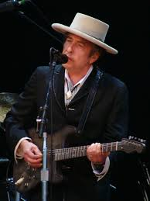
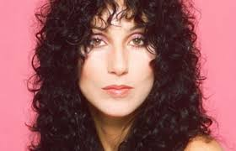
Popular singers and songs
Elvis Presley (Jailhouse Rock)
Bob Dylan (Blowing in the wind)
Tina Turner (The best)
Elton John (Sacrifice)
Cher (Believe)

Slide 7

My favourite song
My favourite song is ‘zombie’ by an Irish rock band called ‘The Cranberries’
I like it because it talks against war and terrorism and all the bad things they bring

Slide 8

References
The internet
My parents

Slide 9
THANK YOU FOR YOUR TIME
MARTHA IOANNOU
Στ 1

