Slide 1


ROCK MUSIC
From Andreas Achilleos 2021

Slide 2
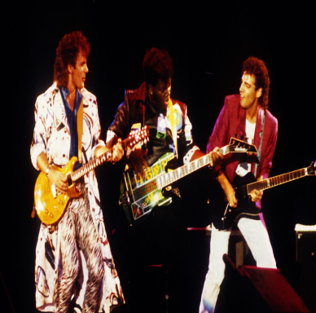
What IS rock music
Rock is a form of music with a strong beat.In the dictionary Rock is defined as a kind of music with simple tunes and a very strong beat played and sung,usually loudly,by a small group of people with electric guitars and drums.

Slide 3

Where and when it started
It started in United States in the 1950, then spread to other English countries and across Europe in the 1960.By 1990 it was globally adopted.

Slide 4
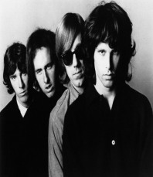
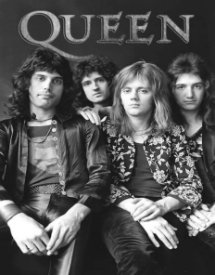
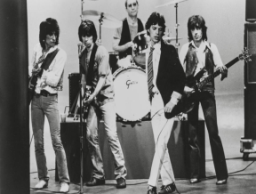
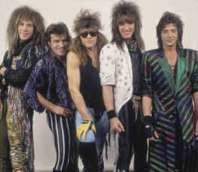
Some of the most important rock bands
The Doors
1965-2016
Queen from 1970
The Rolling Stones
From 1962.
Bon Jovi from 1983

