Slide 1
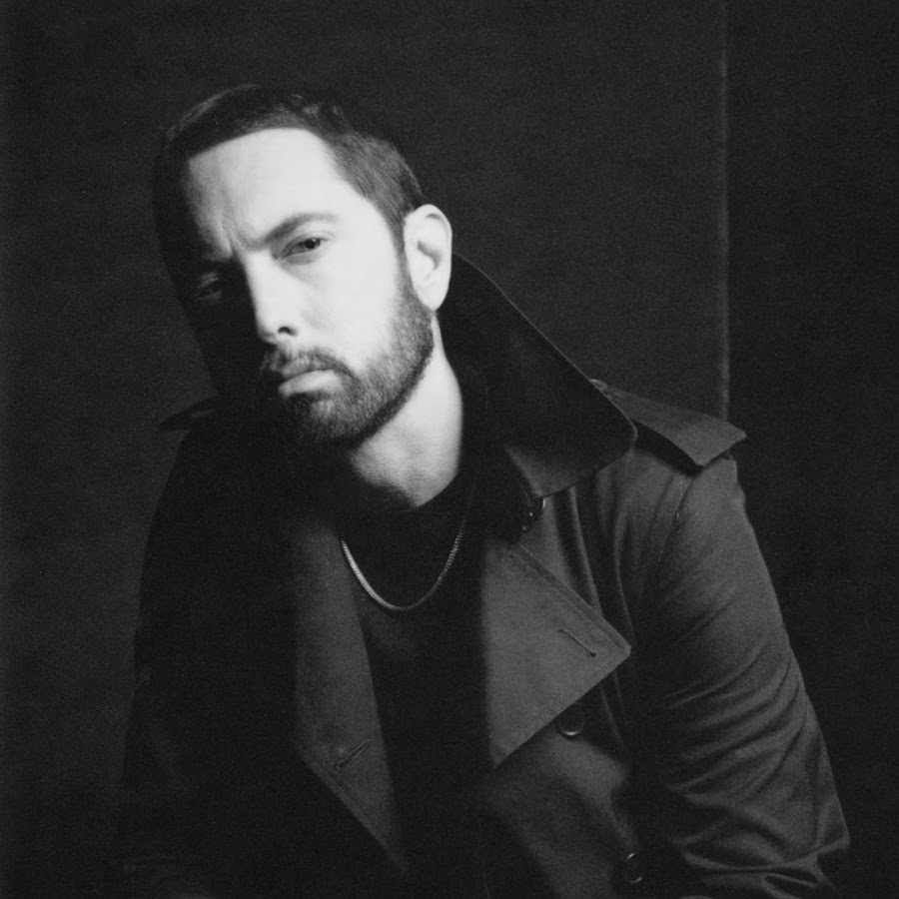
Rap Music
Raphael Anastasiou 6B

Slide 2
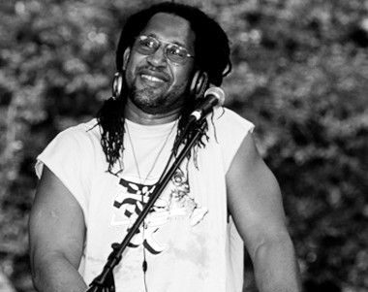
History of rap
Rap music was born in the 1970's bY DJ Kahool Herc who was in charge at parties in New York City.

Slide 3
Why do I prefer this kind of music :
The reason why I prefer this kind of music is because, it helps me relax and think positively. It also gives me motivation to do different things with energy, while listening to rap songs.

Slide 4
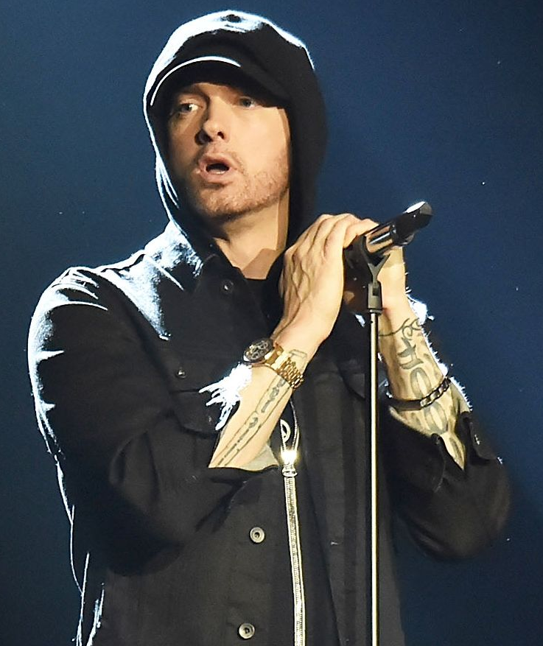

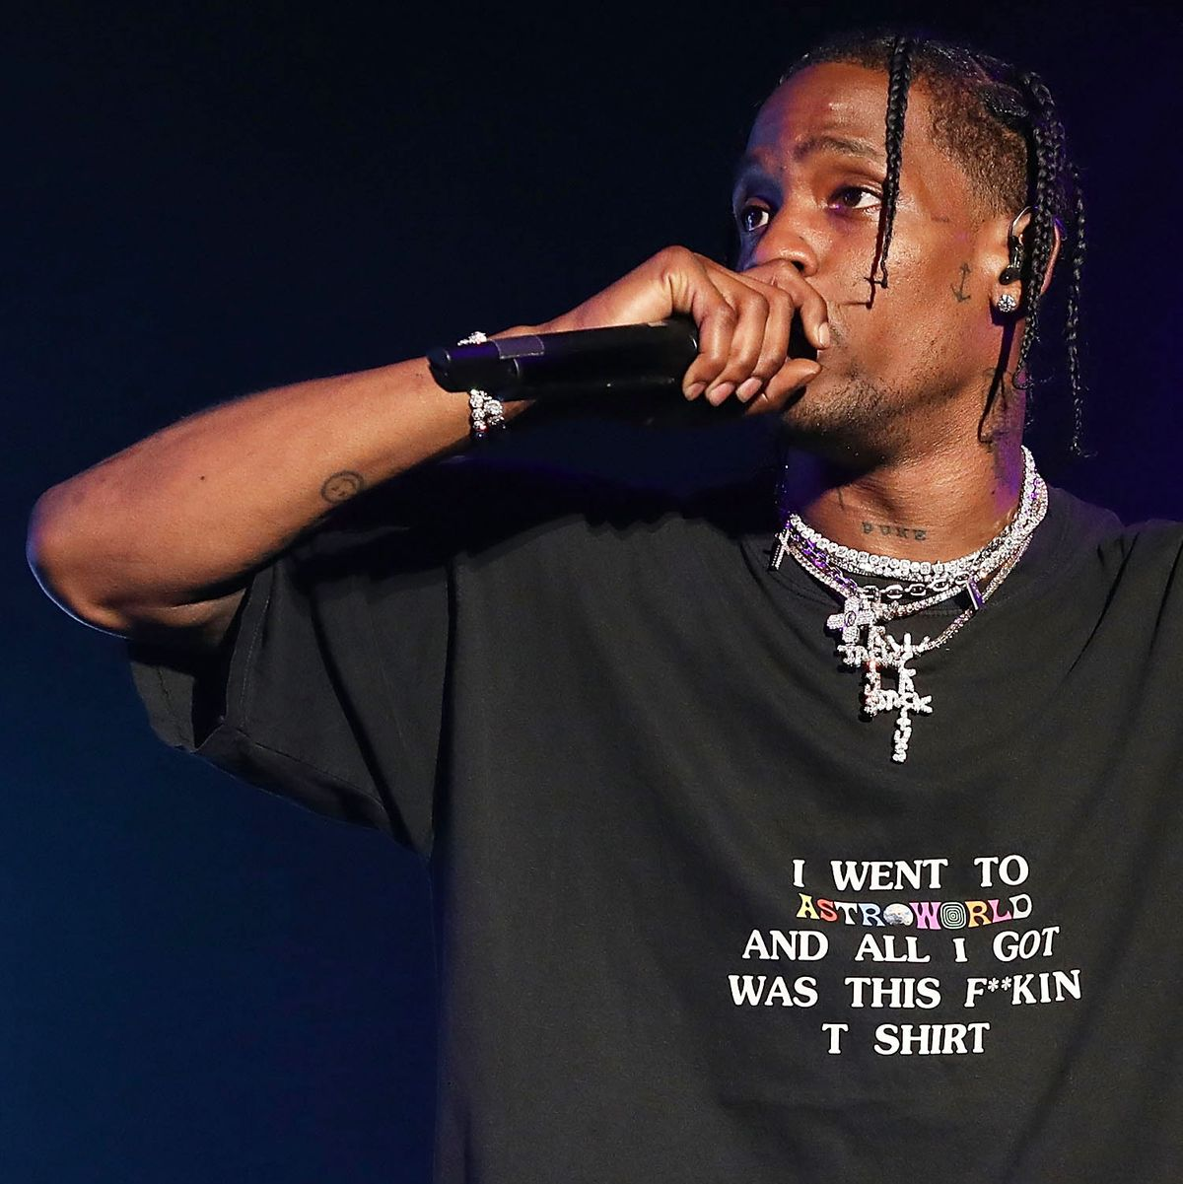
Some Popular Rappers
Drake Travis Scott Eminem

Slide 5


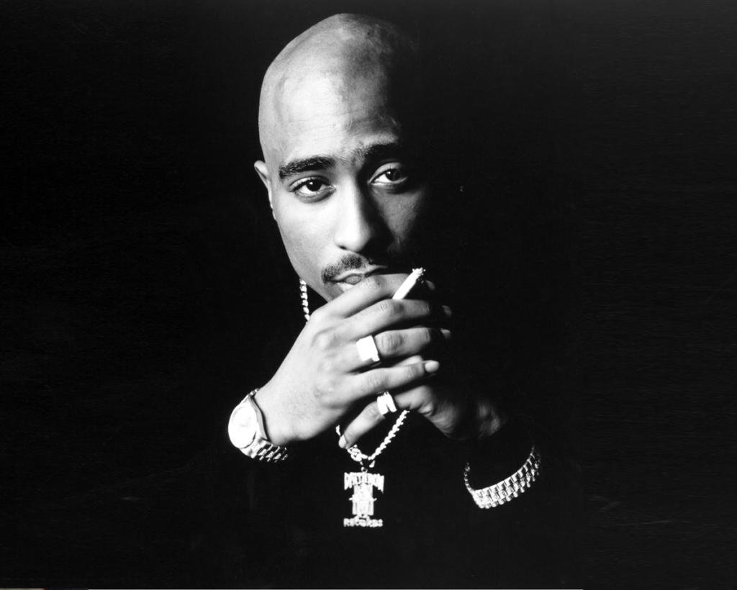
Some Popular Rappers
Snoop Dogg Tupac Juice Wrld

Slide 6
Some Popular Rap Songs
Rap god – Eminem
Juicy – The notorious big
Write this Down – The notorious big
Whats poppin – Jack Harlow
Represent – Nas
California Love – Tupac
Ms. Jackson – OutKast
My name is – Eminem

Slide 7
What's my favourite song :
My favourite song is Rap God by Eminem.
https://youtu.be/XbGs_qK2PQA

Slide 8
References :
https://www.fouroverfour.jukely.com/culture/history-of-rap-hip-hop/#:~:text=DJ%20Kool%20Herc%20is%20widely,instrumental%20portion%20of%20a%20song.
https://www.npr.org/templates/story/story.php?storyId=7550286#:~:text=Rap%20as%20a%20genre%20began,generally%20interacting%20with%20the%20audience.

Slide 9

Thank you for your attention !

