Slide 1

Type of Music: Rap
Prepared by: Neophytos Gregoriades

Slide 2
The Birth of Rap
Rap as a genre began at block parties in New York City in the early 1970s, when DJs began isolating the percussion breaks of funk, soul, and disco songs and extending them.

Slide 3
Roots of rap
Rapping can be traced back to its African roots. Centuries before hip-hop music existed, the griots of West Africa were delivering stories rhythmically, over drums and sparse instrumentation.

Slide 4
Rap as a technique or activity
Rapping is a musical form of vocal delivery that incorporates "rhyme, rhythmic speech, and street vernacular",which is performed or chanted in a variety of ways, usually over a backing beat or musical accompaniment.
The components of rap include "content" (what is being said), "flow" (rhythm, rhyme), and "delivery" (cadence, tone).
Today, the term rap is so closely associated with hip-hop music that many writers use the terms interchangeably.

Slide 5
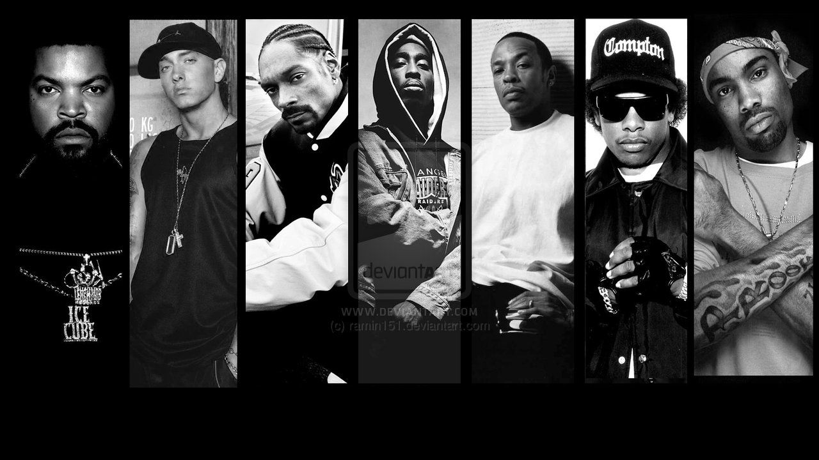
Popular Rap Singers
Travis Scott
Eminem
Dr. Dre
Snoop Dogg
SNIK
Tupac

Slide 6
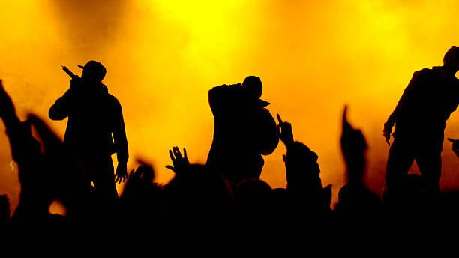
THANK YOU!

