Slide 1


Pop music
This Photo by Unknown author is licensed under CC BY-SA-NC.
Demetria ,Melina ,Iria
6A

Slide 2
What is pop music
Pop is a genre of popular music that originated in its modern form during the mid-1950s in the United States and the United Kingdom. The terms popular music and pop music are often used interchangeably, although the former describes all music that is popular and includes many disparate styles. During the 1950s and 1960s, pop encompassed rock and roll and the youth-oriented styles it influenced. Rock and pop remained roughly synonymous until the late 1960s, after which pop became associated with music that was more commercial, ephemeral, and accessible.

Slide 3

Pop music singers
Ariana Grande
Billie Eilish
Selena Gomez
Justin Bieber
Beyonce
Rihanna
Ed Sheeran
Lady Gaga
Celine Dion
Madonna
Justin Timberlake

Slide 4

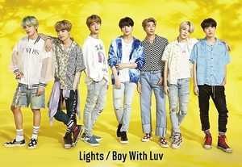


pop bands
One Direction
Little Mix
BTS
BlackP!nk
Rolling Stones

Slide 5

Why I like pop music
Because it inspiresme more than the other types of music and believe that pop songs are better than the rest
It also relaxes me and when I'm sad listening to pop songs makes me feel better

Slide 6
END

