Slide 1
POP MUSIC!!!!!
By kyriaki christou
Αpοstόlοs varnavas
st’ι

Slide 2

Pop Music's History!!!!!
Pop is a genre of popular music that originated in its modern form during the mid-1950s in the United States and the United Kingdom. The terms popular music and pop music are often used interchangeably, although the former describes all music that is popular and includes many disparate styles. During the 1950s and 1960s, pop encompassed rock and roll and the youth-oriented styles it influenced. Rock and pop remained roughly synonymous until the late 1960s, after which pop became associated with music that was more commercial, ephemeral, and accessible.
Wikipedia

Slide 3

Why I like pop music !!!!! :
I love pop music. Because I fell so relaxing and comfortable when I hear them. I’m inspire to do a lots of thinks that I was afraid to do them or I don’t want to. Some times the lyrics from the songs are telling thinks that are connecting to the thinks in my life and i fell that the song is understand me and then I fell more strong and powerful to escape from our problems and from our fears. I fell happy when I hear and sing them and when ever you want you can sing them along or write your own song. Pop Music is my life!!!!!
I wrote them me

Slide 4
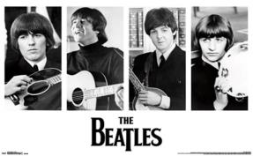
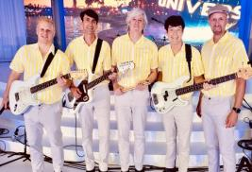
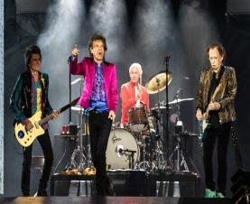
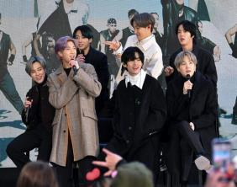
Some Bands!!!!!
The Beatles 1957-1970
The Beach Boys from 1961
BTS
The Rolling Stones from 1962
Queen from 1970
BlackPink
Google

Slide 5
Some singers and some of their songs!!!!!
Singers
Songs
Ariana Grade
Beyoncé
Justin Bieber
Lady Gaga
Miley Cyrus
Ent Siren
Santa tells me, 7 rings, Thank you, next…
Listen, Love on top ,Run the World…..
Baby, I don’t care, Sorry…..
Shallow, Million Reasons, Telephone….
Midnight Sky, We Can’t Stop, Angels Likes You….
Perfect, I See Fire, South OF The Border…

Slide 6

My favourite song!!!!!
My favourite song is called Firework from Katy Perry!!!!

Slide 7
Thank you very much!!!!!
FINISH!!!!!

