Slide 1

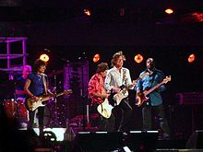

Pop music

Slide 2
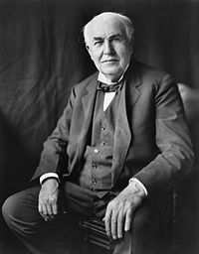
Who discover pop music
The first stirrings of popular or pop music any genre of music that appeals to a wide audience or subculture began in the late 19th century, with discoveries by Thomas Edison and Emile Berliner. In 1877, Edison discovered that sound

Slide 3
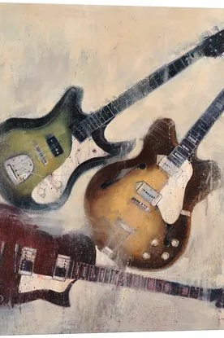
Why I picked pop music
I like it not just because is popular it’s because I like modern music and my favorite song are pop music

Slide 4

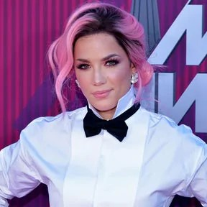
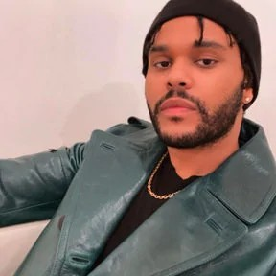
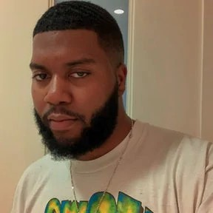
Some pop music singers

