Slide 1

My favourite singer
Name:Fedra Stavrou
Class:Year 6
Teacher: Efi Ioannidou

Slide 2
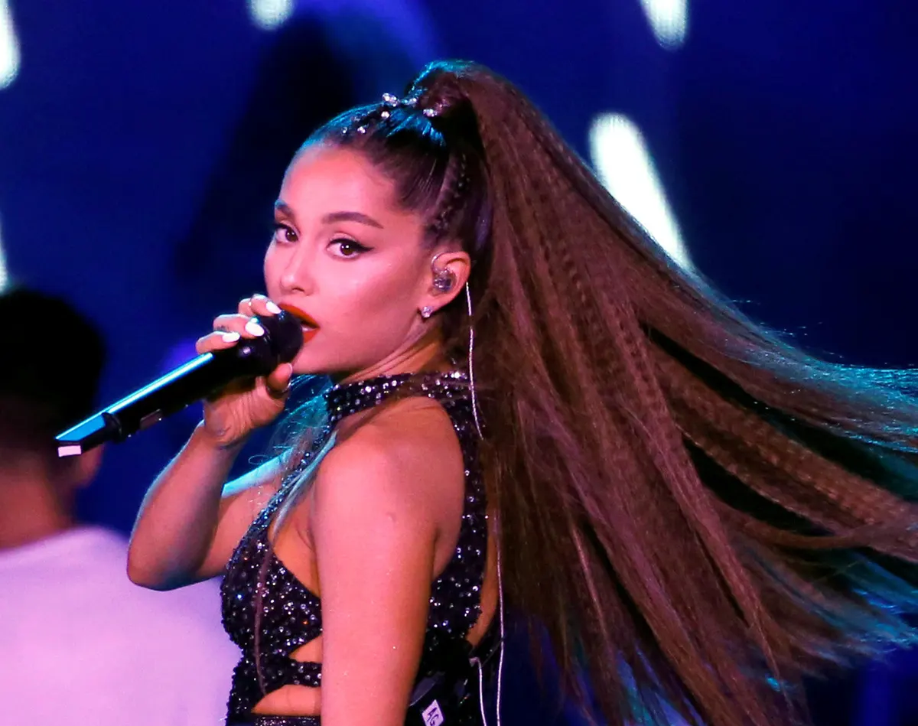
Ariana Grande
Ariana Grande was born at the 26th of June 1993 and she is now 27 years old.She was born in Boca Raton,Florida and she is an American singer and actress.

Slide 3
Her songs
7 rings
Bang Bang
Thank u,next
Rain on me
Side to side
Santa tell me
God is a woman
The way
Needy
Last Christmas
In my head
Fake smile
Into you
One last time
No tears left to cry
Problem
Break up with ur girlfriend
Love me harder
Break free
Boyfriend
Don’t call me angel
Breathin
Almost is never enough
Focus
Dangerous woman

Slide 4
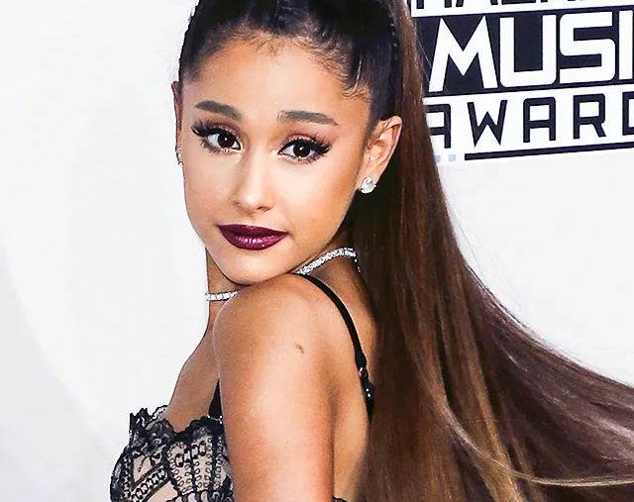
About her
She has an older half-brother, Frankie Grande, who is an entertainer and producer,^{[14][15]} and she has a close relationship with her maternal grandmother, Marjorie Grande.^{[16]} Grande's family had moved from New York to Florida before her birth, and her parents separated when she was approximately nine or ten years old.^{[11]}

Slide 5
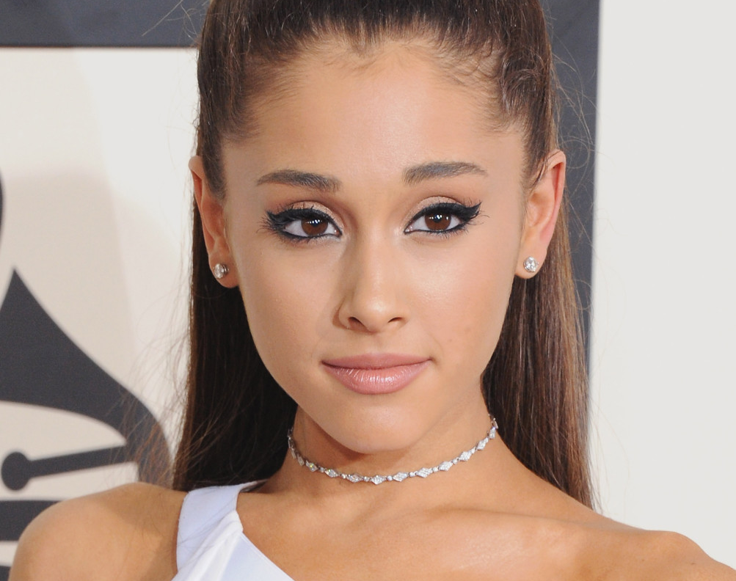
As a kid
As a young child, Grande performed with the Fort Lauderdale Children's Theater,^{[17]} playing her first role as the title character in their version of the musical Annie. She also performed in their musicals The Wizard of Oz and Beauty and the Beast.^{[12][18]} At the age of eight, she performed at a karaoke lounge on a cruise ship and with various orchestras such as South Florida's Philharmonic, Florida Sunshine Pops and Symphonic Orchestras, and she made her first national television appearance singing "The Star-Spangled Banner" for the Florida Panthers.^{[19]} During this time she attended Florida's Pine Crest School and later North Broward Preparatory School.^{[20]}

Slide 6
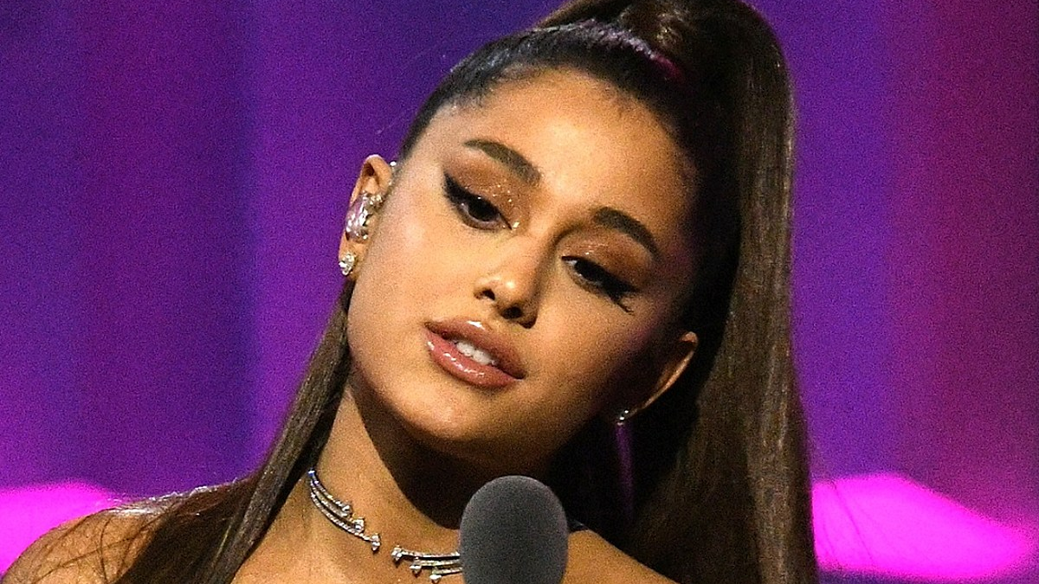
Thanks for your attention

