Slide 1

MY FAVORITE MUSIC
Student: Constantinos Kyriacou
School: Primary school Apostolos Varnavas
Class: 6B

Slide 2

Music can be found anywhere in everyday life.
It can be found on the radio, on television, on computers and on our phones.

Slide 3


My favorite music is Rap that is very easy to dance to and it helps put me in a mood to have fun.
Rap music became universal.
It is defined as popular music that consists of a repeated beat pattern.

Slide 4


About Rap
Rap is a musical form of vocal delivery that incorporates rhyme and rhythmic speech which is performed in a variety of ways, usually over a backing beat. The components of rap include "content" (what is being said), "flow" (rhythm, rhyme) and "delivery" (tone).

Slide 5
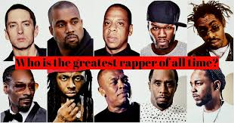


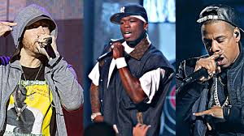

Famous rap singers
Eminem
Lil Wayne
Kanye West
Meek Mill

Slide 6


