Slide 1

MUSIC THRough THE DECADES
Constantinos Vassiliou
KYRIAKOS TIMOTHEOU
6A

Slide 2

THE NUMBER 1 HIT IN THE 70’s

Slide 3

HOW DEEP IS YOUR LOVE
This song was the number 1 hit for 33 weeks
This song was written by the band called Bee Gees in 1977 and its genre is rock
The members of the Bee Gees were Robin,Barry and Maurice Gibb
https://beegees.lnk.to/subscribe

Slide 4

THE NUMBER 1 HIT IN THE 80’S

Slide 5
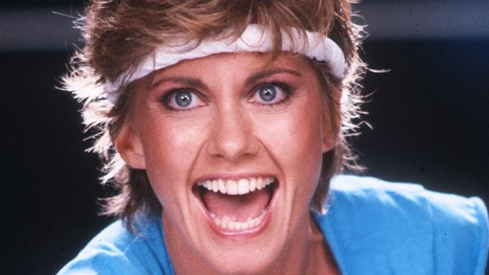
THE SONG IS CALLED PHYSICAL
The song was sang by Olivia Nuton- John
The song was written by Terry Shaddick and Steve Kipner
The song was the number 1 hit for 10 weeks

Slide 6


THE NUMBER 1 HIT IN THE 90’S

Slide 7
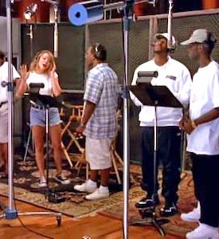
one sweet day
This song was preformed by Mariah Carey and Boyz II Men
This song was the number 1 hit for 16 weeks
The genre of the song is Contemporary R&B

Slide 8
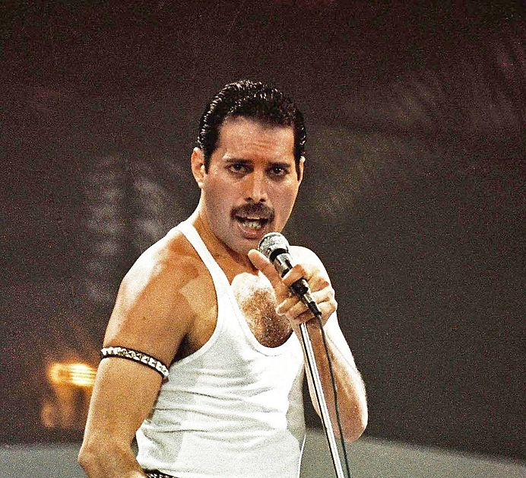
FREDDIE MERCURY
FREDDIE MERCURY WAS BORN IN 1946 and died in 1991
FREDDIE MERCURY WAS REGARDED AS ONE OF THE BEST ROCK SINGERS
TWO OF HIS BEST SONGS WERE WE WILL ROCK YOU AND BOHEMIAN RHAPSODY

Slide 9

THANKS FOR WATCHING

