Slide 1

K - POP
Smaragda Abou Ayiash
6A grade

Slide 2


What is K – Pop for me ?
K – Pop helped me learn to love myself, to talk to myself and to be myself. When I can listen to K-pop I feel like I can do everything I want in my life and I feel stronger.

Slide 3

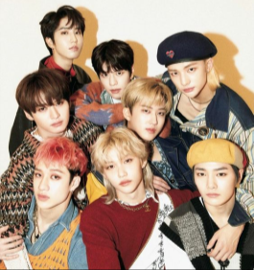
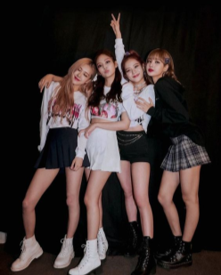
My favorite K – Pop groups
My favorite K – Pop groups are :
BTS
Stray Kids
Blackpink

Slide 4

This is one of my favorite K-Pop album!
BE - BTS

Slide 5
This is one of my favorite songs for this album!
Life goes on
Like an echo in the forest
The day will come back around
As if nothing happened
Yeah life goes on
Like an arrow in the blue sky
Another day flying by
On my pillow, on my table
Yeah life goes on
Like this again
BTS

Slide 6

I’m glad that I have K-Pop in my life all this time and I’m really happy to love myself and be myself with music!

Slide 7
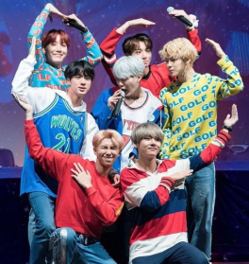
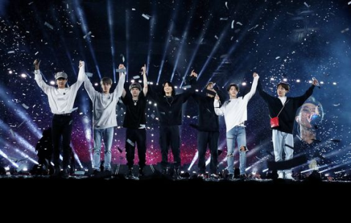
THANKS FOR WATCHING!

