Slide 1

JAZZ MUSIC
PANAYIOTIS STYLIANOY 6B

Slide 2
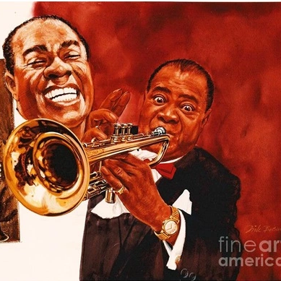
WHAT JAZZ MUSIC IS?
The jazz is a musical genre that was popular development of American music in the 19th century , with African origins . It experienced significant growth and international recognition during the 1920s

Slide 3
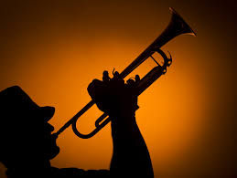
JAZZ HISTORY
Jazz showed up at the start of the 20th century when African slaves were talking with music because their boss didn’t let them to talk so they played music to talk to each other.

Slide 4
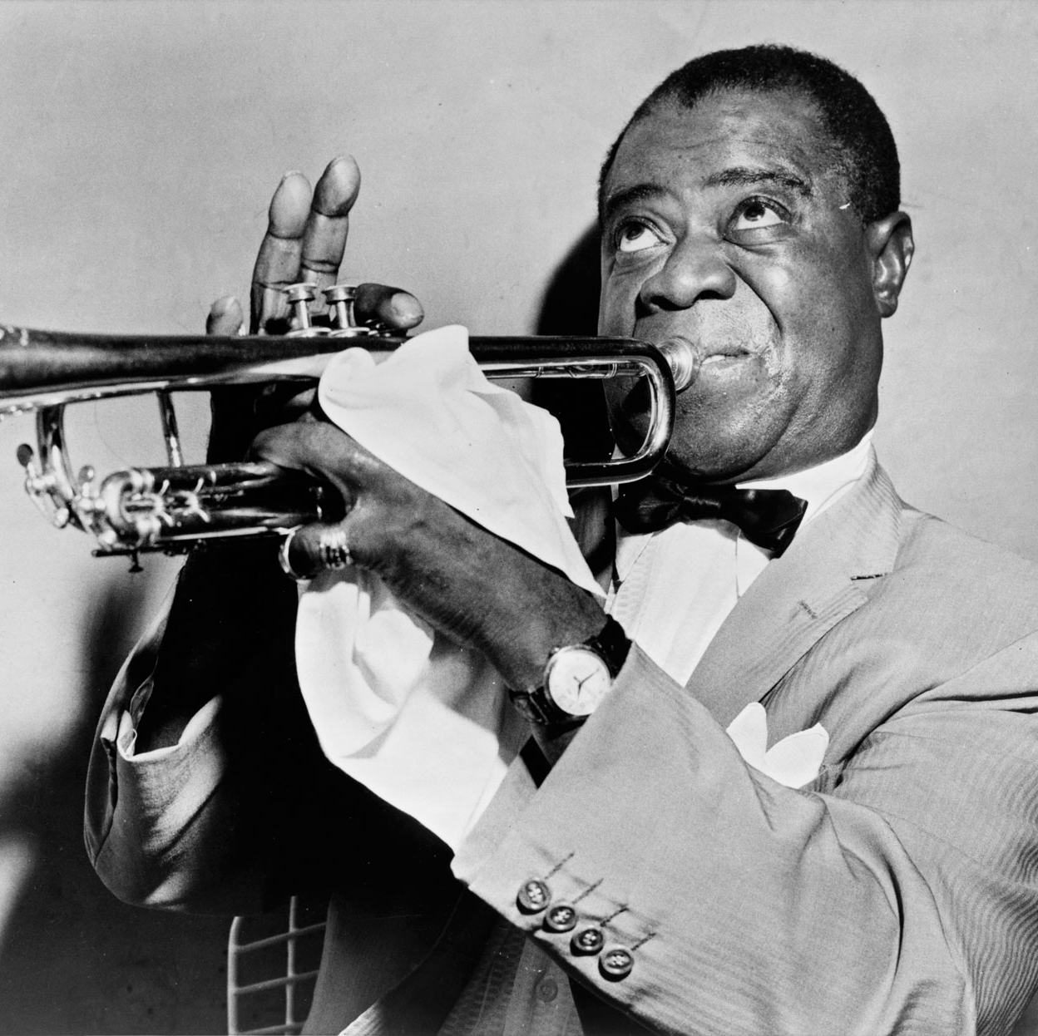
Famous jazz musicians
There are a lot of famous jazz musicians. Some of them are Miles Davies, Wynton Marsalis and the most famous jazz musician Louis Armstrong.

Slide 5
SOURCES
Https://el.wikipedia.org/wiki/%CE%A4%CE%B6%CE%B1%CE%B6
Pupils Book

Slide 6

THE END

