Slide 1


Katerina M ΣΤ’2 Αποστόλου Βαρνάβα

Slide 2

The words hip/hop/, imitating the sound of soldiers marching, in reference to a friend who had joined the army.
How did hip hop got its name
Hip-hop — they were the first words on the genre’s first big hit, the Sugar hill Gang’s 1979 song, “Rapper’s Delight.” But at the time no one not even the young kids who had invented the music, the dances, the rhymes, and the visual art of this burgeoning movement emerging from the Bronx. Hip-hop wasn’t hip-hop yet.

Slide 3
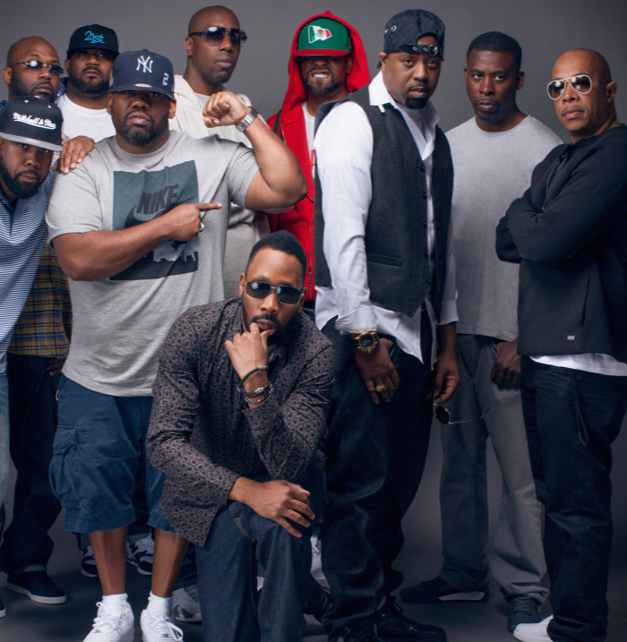
When did hip hop became famous
The golden age of hip-hop, from 1986 to 1993, gave the world an amazing number of great records," and also describes the period in November 1993, when A Tribe Called Quest and Wu-Tang Clan released albums, as "The Next Golden age."

Slide 4



Some hip hop singers
Nicki Minaj
Ariana Grande
Cardi B

Slide 5


Some Greek hip hop singers
Sadahzinia
Stereo Mike

Slide 6


