Slide 1

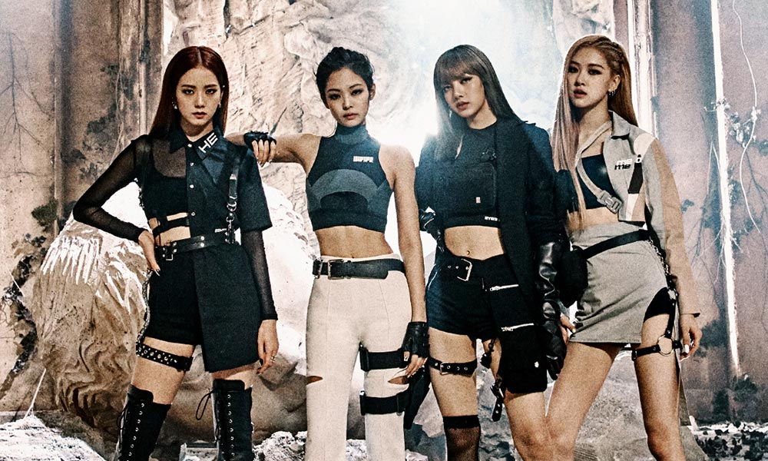
K -pop
Jisoo
  Rose
Jennie
Lisa

Slide 2

What is k-pop
Κ-pop short for Korean pop.
K-pop is a genre of popular music from south Korea.
It is influenced by styles and genres from around the world such as experimental rock, jazz, gospel, hip hop, r8b etc on top of its traditional Korean music roots
the more modern form of the genre emerged with the formation of one of the earliest k-pop groups seo taiji and boys in 1992.

Slide 3


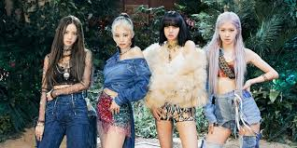

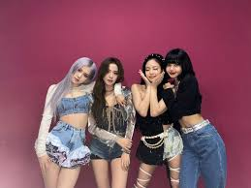
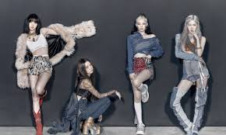

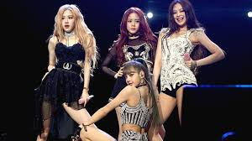
Who is blackpink
My favorite K-pop group
Blackpink is a South Korean girl group formed by YG Entertainment, consisting of members Jisoo, Jennie, Rosé, and Lisa. The group debuted in August 2016 with their single album and it was the first girl group to debut under YG Entertainment in seven years
The members of the group were chosen following stiff competition. 4 members were chosen out of 4000 applicants inly in Thailand
According to a label representative, the group's name meant "pretty isn't everything" and symbolized that "they are a team that encompasses not only beauty, but also great talent.“
They won first place on Inkigayo thirteen days after their debut, breaking the record for the shortest time for a girl group to win on a music program after debut.
They have gained worldwide recognition and have many successes, including the winning of many prices and the creation of their own TV show and documentary

Slide 4

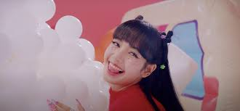
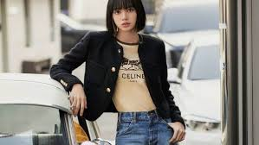

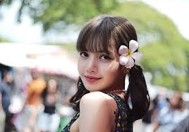


LISA Facts:
Lisa was born in Buriram Province, and moved in Bangkok, Thailand at age three. Lisa is an only child.
Lisa’s stepfather who’s a top certified Swiss chef in Thailand is Marco Brueschweiler.
Formerly, her name was Pranpriya and her friends called her by the nickname Pockpack.
She was the only person out of 4000 accepted to YG in the YG Audition in Thailand 2010.
She trained for 10 years and 3 months.
She became a trainee during middle school and lived in Korea since.
She can speak Korean, English, Japanese, Thai and basic Chinese.
She was voted as the best at aegyo in Blackpink by all members.Lisa is referred to as the “Thailand Princess” in her birthplace.
She appeared in BIG BANG Taeyang’s ‘Ringa Linga’ MV.
Lisa loves make-up a lot
Lisa plays Ukulele.
She can also play the guitar.

Slide 5
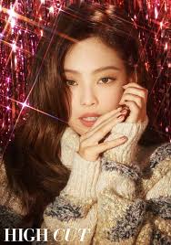
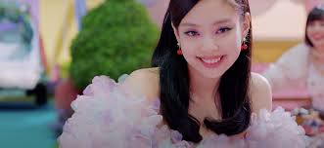
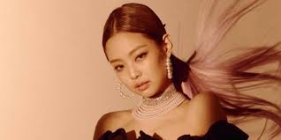
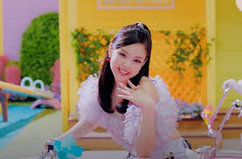

:
– She was born in Anyang, a city in the province of Gyeonggi, South Korea.
– She doesn’t have any siblings.
– Jennie lived in Auckland, New Zealand for 5 years.
– She studied in New Zealand at ACG Parnell College.
– Jennie is known as ‘the YG princess’ in the group.
– One of her nicknames used to be “Human Gucci” due to the fact that she often wears expensive clothing from Gucci, nowadays it’s ‘Human Chanel’.
– She had “mandukie” as a nickname because her cheeks looks like a dumpling and dumpling in Korea is “Mandu”.
– Jennie said that her nickname when she was young was Jerry, because of Tom and Jerry, and Jerry sounded like Jennie, so that’s how she got it.
– She also has the nickname NiNi, she will call herself it all the time when posting on the Vapp or IG.
– Jennie’s Chinese zodiac sign is Pig.
– She trained for 5 years 11 months– She is fluent in Korean, Japanese, and English.
who is Jennie

Slide 6
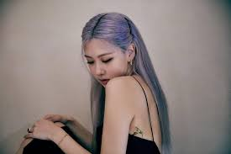
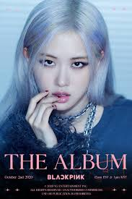
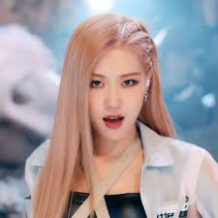
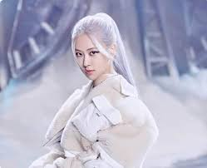


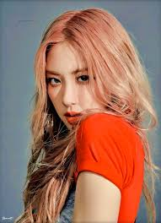
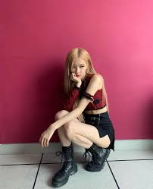
She is Korean, but she was born in Australia, New Zealand (according to Rose during V Live; and according to Rose during Radio star), and raised in Melbourne, Box Hill (Australia), where she attended Canterbury Girls Secondary College.
– She moved to Korea back in 2012. (according to Rose during Weekly Idol)
– Rosé placed first in YG auditions in Australia.
– Rosé has adopted a dog Hank
– Her Chinese zodiac sign is Ox.
– She trained for 4 years 2 months
– Pre-debut, Rosé used to be a cheerleader in Australia.
– When she was younger, Rosé joined a choir, singing in churches in Australia.
– She’s known for her unique voice
– Rose is known as “Blackpink’s Goddess”.
– Rose joined the group on May 7th and Lisa’s first thought on her when they met on the elevator was “Oh! I got a special vibe from her! Australia!”
– She can speak Korean, English, Japanese.
– She collaborated with G-Dragon for the song ‘Without You
Rose facts
Who is rase

Slide 7
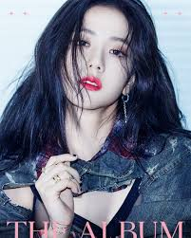
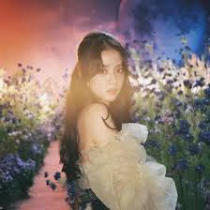

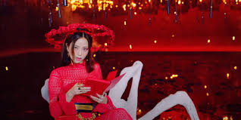
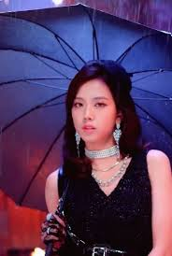
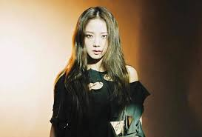
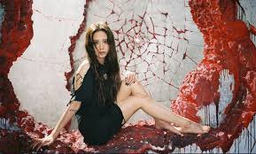
Jisoo was born in Gunpo, a city in the province of Gyeonggi, South Korea. she is the youngest.
She trained for 5 years (since July 2011).
Jisoo’s Chinese zodiac sign is Dog.
She laughs a lot.
She likes giving random nicknames to people.
According to Jennie, Jisoo is the mood maker of the group.
Jisoo loves telling dad Jokes
Who is jisoo

Slide 8
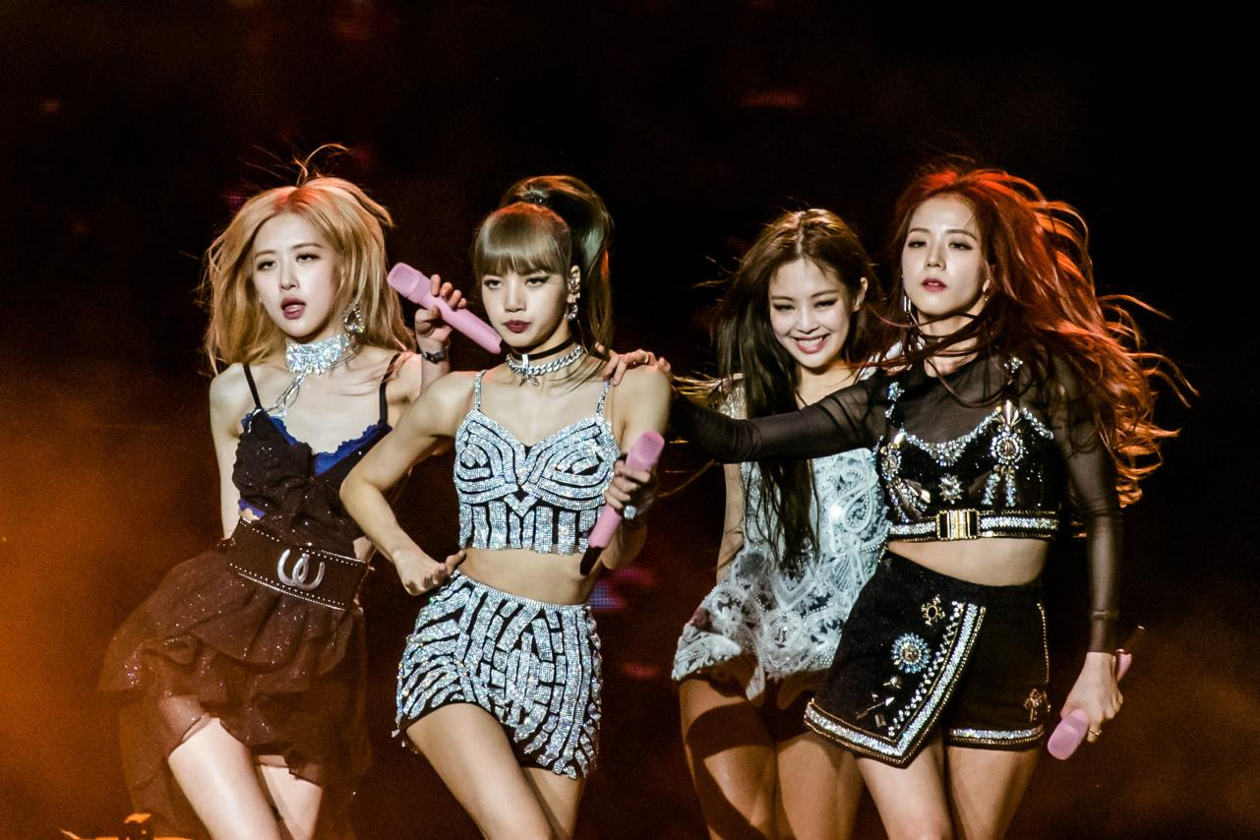
Why I like blackpink
K-pop
I like blackpink because they are very talented, intelligent and cute but at the same time very strong and clever young women. I find them very inspirational
Why I like k-pop music
I like k-pop music because it is very unique and special. I like the way they dance and the way they dress.

Slide 9

K-pop music
Georgia Themistokleous
ST’2
Ephy Ioannou
https://www.youtube.com/watch?v=dyRsYk0LyA8

