Slide 1

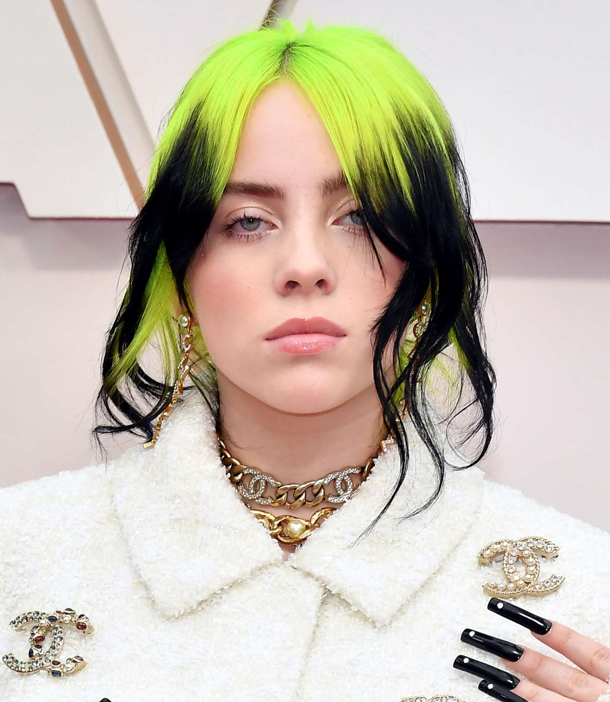
Billie Eilish Singer-Songwriter
Clio Kyriacou 6B Apostolos Varnavas Primary School

Slide 2


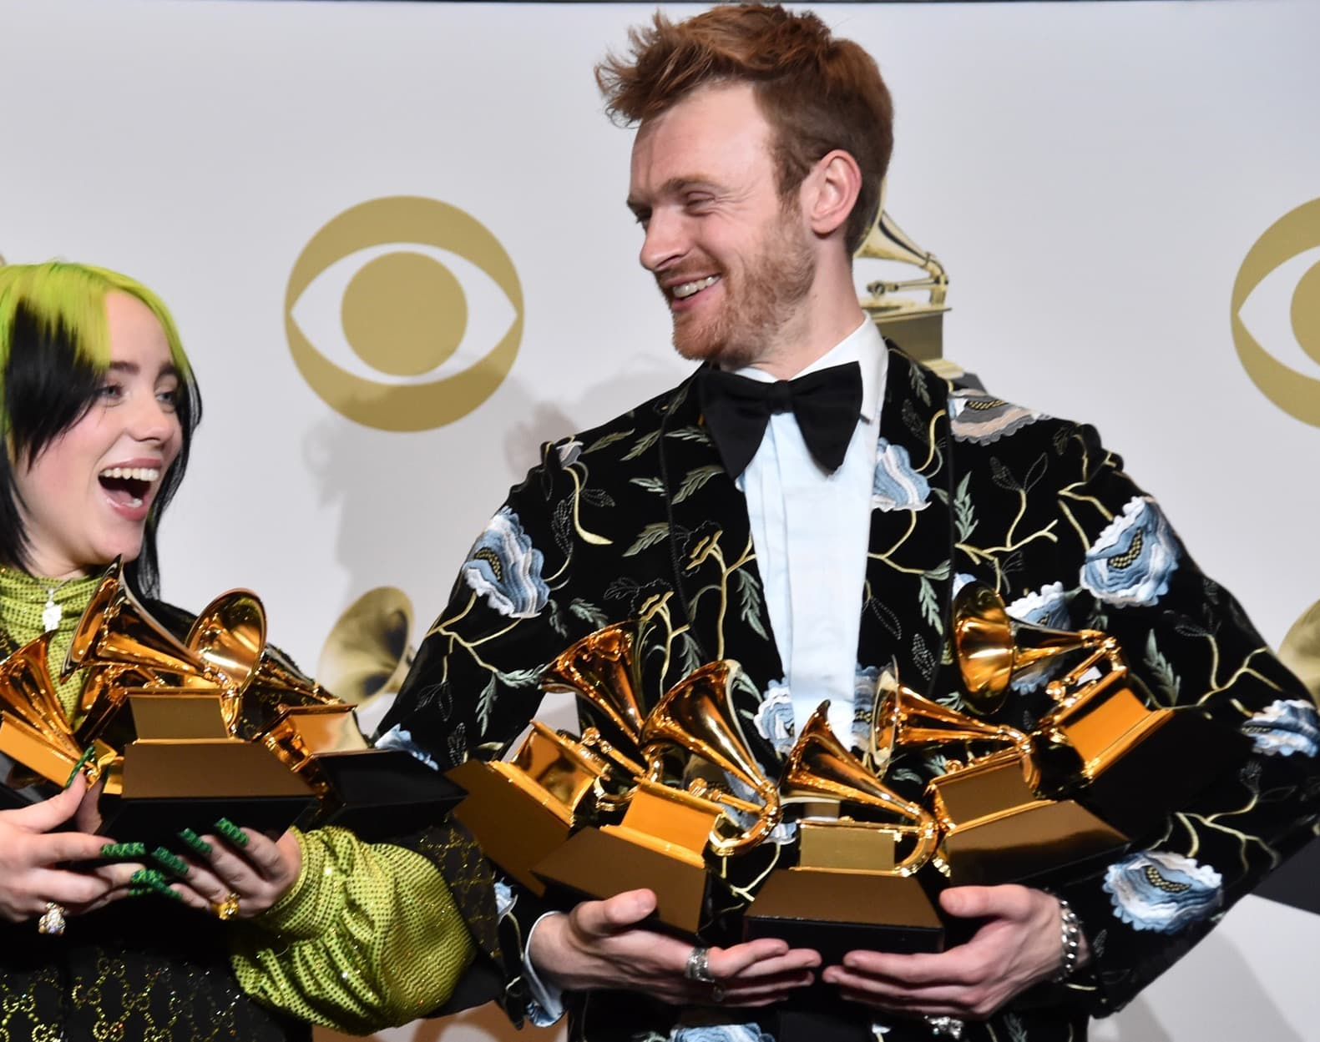
General Information
Full name: Billie Eilish Pirate Baird O’ Connell
Nationality: American
Birthday: December 18, 2001
Top Songs: Bad guy, Ocean Eyes, No time to die, Don’t smile at me
Billie was born in Los Angeles, California. She was homeschooled so her mother taught her with her brother, Finneas, the basics of song writing. They worked together and they compose “No time to die” and many other songs.

Slide 3

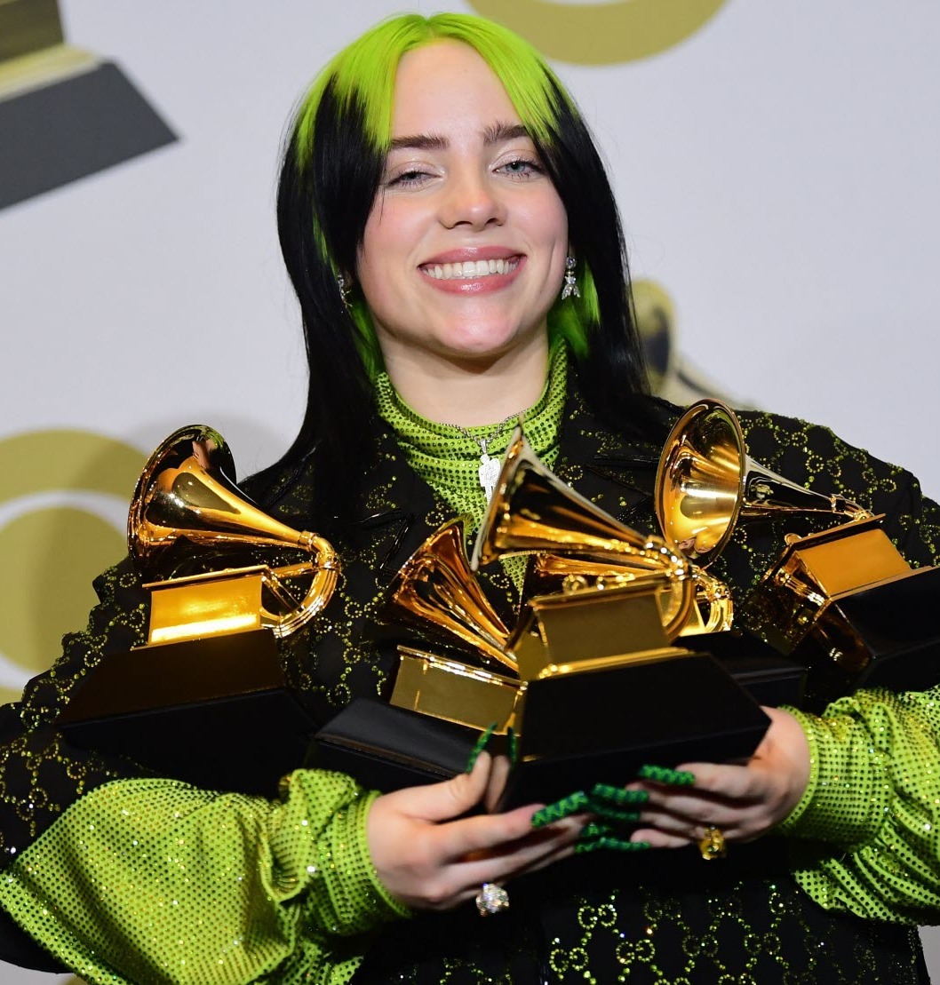
Awards
Billie won five Grammy Awards, two Guinness World Records, two American Music Awards, two MTV Europe Music Awards, one NRJ Music Awards, one Billboard Music Awards, one Brit Award and three MTV Video Music Awards. She is the youngest person in history to win the four main Grammy categories in the same year.

Slide 4
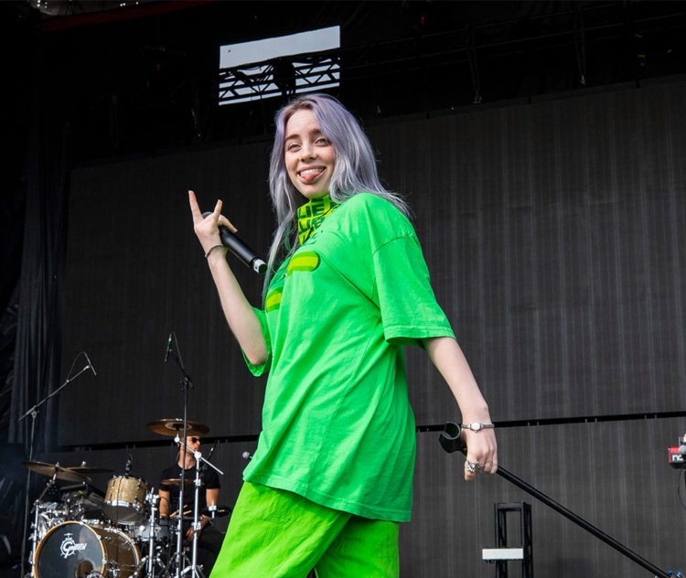

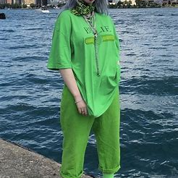
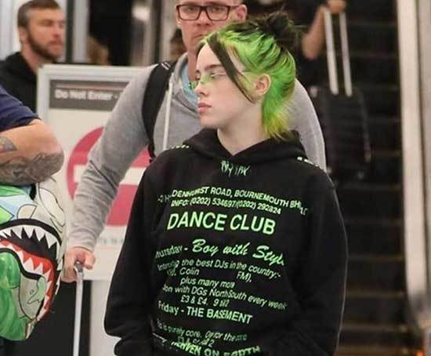
Style
Billie usually wears green and black hoodies or t-shirts. She changed her hear to a lot of colors like blue, green, light blue even and red.

Slide 5

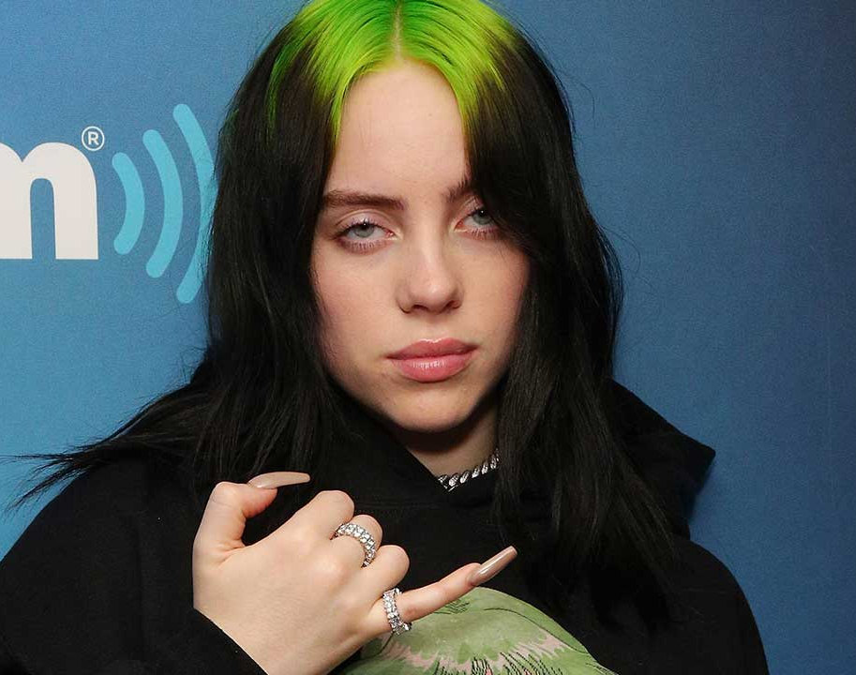
Instruments
She can play the piano and the ukulele, but she is more famous about her voice.
Billie Today
Billie lives with her parents in Los Angeles. She is also getting ready for her 2021 tour.

Slide 6


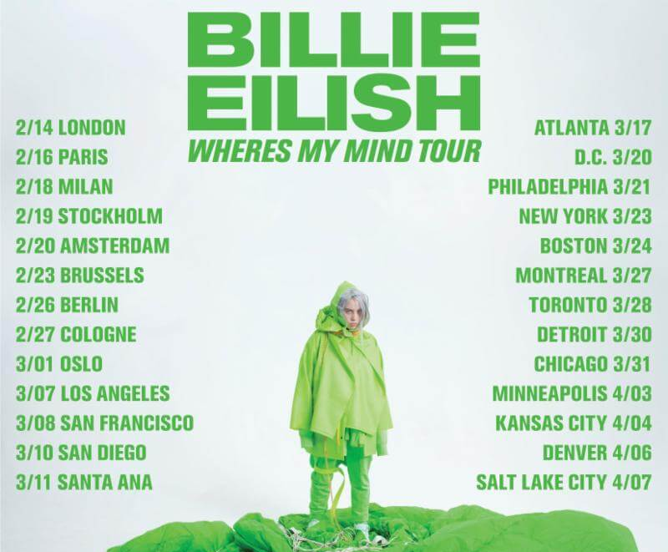
World Tours
Don’t Smile At Me {2017} Where’s My Mind {2018} 1 by 1 {2018-2019} When we All Fall Asleep World Tour {2019} Where Do We Go? World Tour {2021}

Slide 7



