Slide 1



ABBA
Marilita Alkibiade
6b
Apostolos Varnavas Primary Shcool

Slide 2


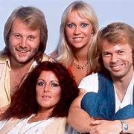
General
ABBA is a pop group formed in Stockholm by Agnetha Fältskog, Björn Ulvaeus, Benny Andersson, and Anni-Frid Lyngstad. The name is an acronym of their names . They are one of the best-selling music artists of all time and one of the most successful acts in popular music worldwide from 1974 to 1983.

Slide 3
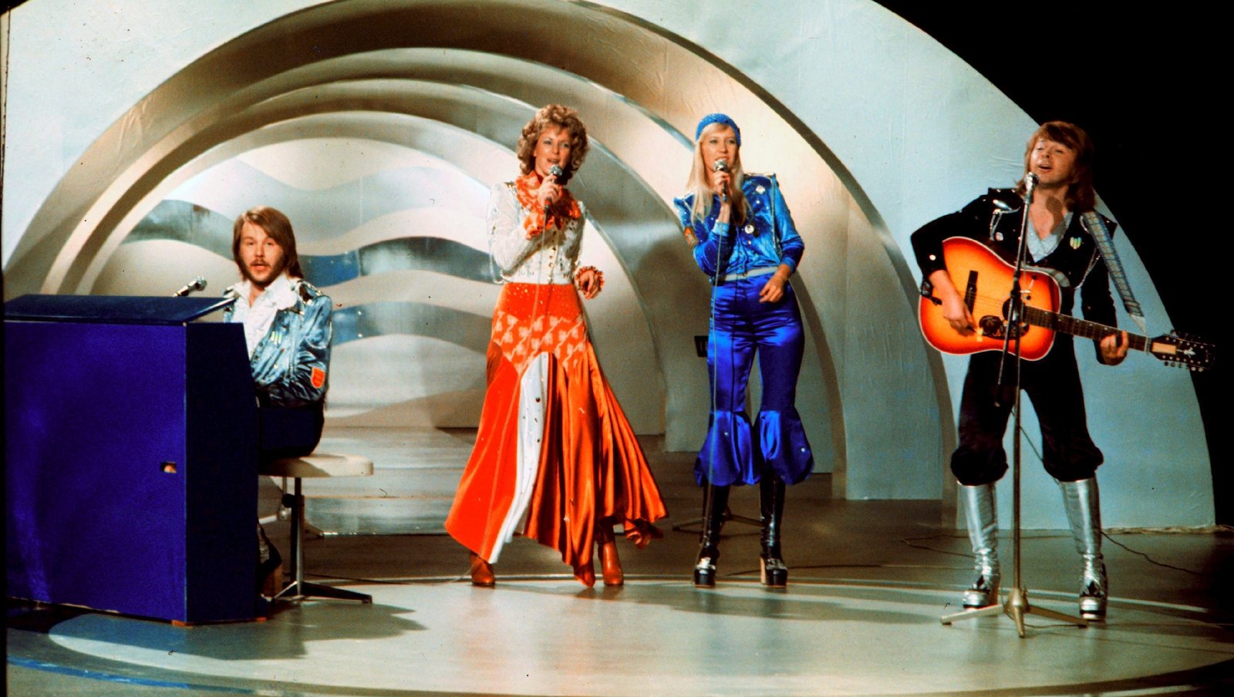
In 1974 ABBA became Sweden's first winner of the Eurovision Song Contest, with the song "Waterloo", which in 2005 was chosen as the best song in the competition's history as part of the 50th anniversary celebration of the contest.

Slide 4

MAMA MIA
In 1999, ABBA's music was adapted into the successful musical Mamma Mia! that toured worldwide. A film of the same name, released in 2008, became the highest-grossing film in the United Kingdom that year. A sequel, Mamma Mia! Here We Go Again, was released in 2018. That same year it was announced that the band had recorded two new songs after 35 years of being inactive.

Slide 5

Some of their popular songs
Mama mia
Dancing queen
Chiquitita
Super truper
Happy new year

Slide 6

Sources: Wikipidia

Slide 7


