Slide 1
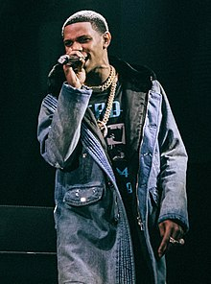
A Boogie wit da Hoodie

Slide 2
Artist Julius Dubose (born December 6, 1995), known professionally as A Boogie wit da Hoodie (or simply A Boogie), is an American rapper, singer, and songwriter. He is signed to his own label, Highbridge the Label, and Atlantic Records. His stage name is derived from the character "Ace Boogie" from the 2002 film Paid in Full, and because he was wearing hoodies all the time, friends gave him the nickname “A Boogie Wit Da Hoodie”. ^{[1]}

Slide 3
Early life
Artist Julius Dubose was born on December 6, 1995 in the Highbridge, Bronx in New York City.^{[6]} Dubose was raised in Highbridge and began rapping at age twelve after listening to Kanye West and 50 Cent.^{[7][8]} He attended Eagle Academy, where he expanded upon rapping during his freshman year, performing in cyphers at lunchtime by performing rhymes he had already written and stored in a large notebook he carried with him.^{[9]} Remarking on his time in high school to XXL, he said "I was regular, nobody really noticed me. I was the one in the back of the classroom, quiet."^{[10]}
Growing up, Dubose frequently got into legal trouble, mainly for selling cannabis and narcotics.^{[9]} After finding out what he was doing, Dubose's parents sent him to Florida as punishment. He graduated from high school at the Performance-based Preparatory Academy in Fort Pierce, Florida.^{[7]} In Florida, Dubose was kept under house arrest. During this confinement, he began to work on his artistry, starting off by tweaking his self-composed rhymes and gradually leading one thing to another. He even built an amateur studio inside the flat that he lived in. Following his graduation from high school, Dubose continued to focus on his music while working jobs in different sectors including construction and pizza delivery.^{[11]}

